Slide 1
Hydro Informatics
Presentation
Mitul Garg
2020102026

Slide 2
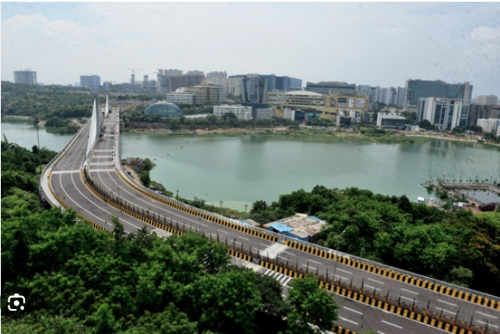
Water related problems in Hyderabad
We choose the Lake - Durgam Cheruvu for analysis.

Slide 3
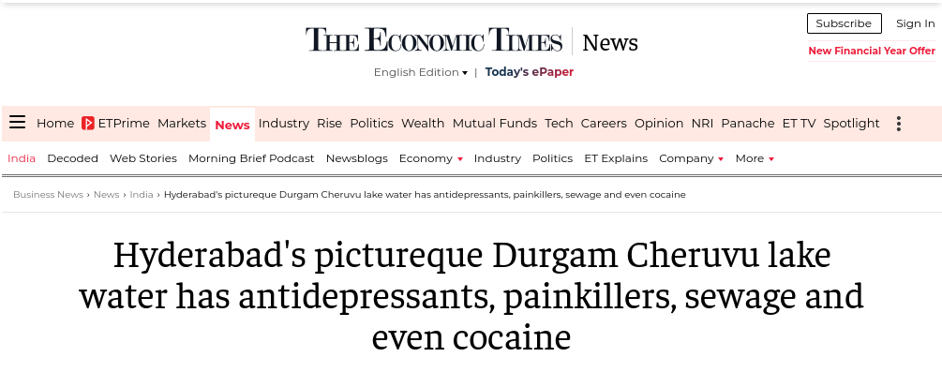
Introduction
Emerging Problems :
Surveys found that Durgam Cheruvu lake water has antidepressants, painkillers, sewage ,cocaine and heavy metals. Leading to unsafe and polluted water condition in the nearby area. Lots of Dead fish found in the lake.
Historical Overview:
Durgam Cheruvu has a rich historical and cultural significance dating back several centuries.
The name "Durgam Cheruvu" translates to "Secret Lake" in Telugu, reflecting its secluded and hidden location.
Current Status: The Telangana government has undertaken beautification projects around the lake, including the construction of walking trails, viewing decks, and landscaped gardens.

Slide 4
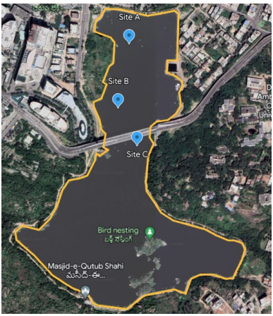
Analysis of Pollution levels
Samples from the lake were collected in March 2023 using a boat at a depth of 30 cm, from 3 sites and the study was performed.
A total of about 183 compounds were identified in the three sampling sites of the lake. These compounds were categorized as pharmaceuticals, metabolites, herbicides, fungicides, insecticides, pesticides, hormones and steroids, personal care products (primarily UV filters), plasticizers, cyanotoxins, and heavy metals like Lead, Arsenic etc.

Slide 5
Major Reasons
Untreated sewage and wastewater
Encroachment and Urbanization
Sedimentation of waste at times of cultural practices :
Immersion of Ganesha Idols
Flowers and Clay waste
POP deposits
Littering and Contamination
Eutrophication
High levels of Cyanotoxins like Microcystin-LR and Anatoxin-a were reported in the survey.

Slide 6
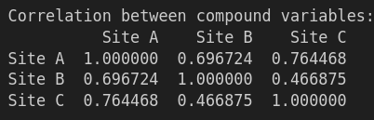
Analysis Done
I tried to find a correlation between the three sites for which we get the following results ->
Sites A and C had a better correlation, while site B and site C were weakly related.
The site wise different levels indicate waste movement throughout the lake.

Slide 7
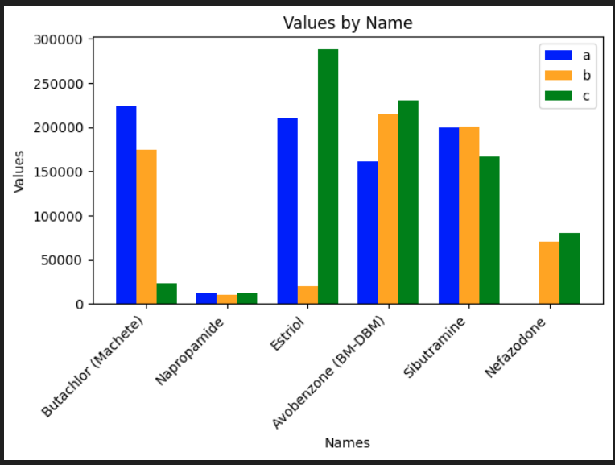
Analysis Done
We then analyse the different compounds we found in the lake and try to devise some analysis from it :
Nefazodone was detected only at sites B and C. This drug is used to treat severe depressive disorders, aggressive behavior, anxiety, and panic disorders.
This shows that nearby pharma companies dump the waste into the lake.

Slide 8
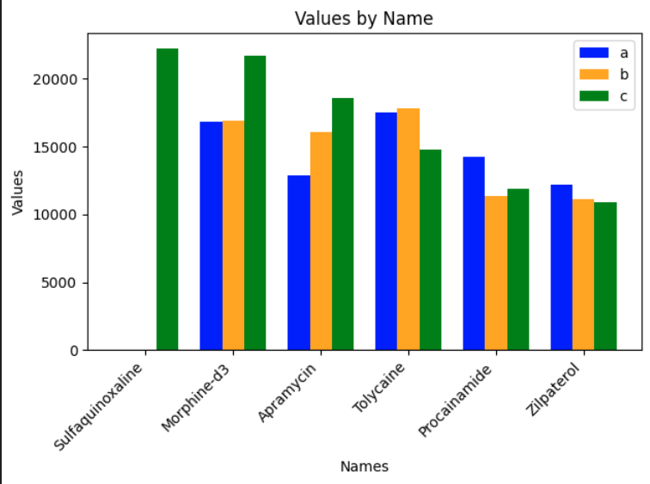
Analysis Done
Sulfaquinoxaline, a veterinary drug given to cattle and sheep; Clarithromycin-N-oxides, a urinary metabolite of antibiotics; and Temazepam, commonly used to treat severe insomnia were detected only at sites B and C.
This shows wastewater discharge at these locations.

Slide 9
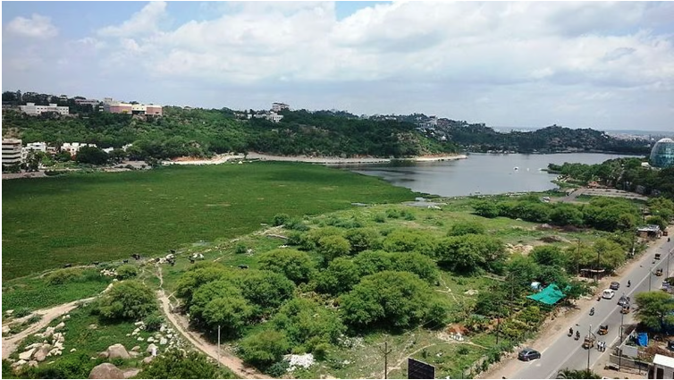
Analysis Done
Reasons for such observations :
The lake had been surrounded by pharma companies and pesticide dealers.
The presence of urinary metabolites is a sign that the discharge of domestic wastewater discharge into the lakes is from nearby areas of Madhapur and Jubilee Hills.
High levels of Eutrophication.

Slide 10
How to Improve
Several measures can be taken to improve the condition of the Lake:
Source Control
Putting regulations on the nearby pharmacy and pesticide dealers.
Putting regulations on sewage treatment and wastewater management authorities in nearby areas like Madhapur and Jubilee hills.
Community Engagement
Encouraging people to prevent throwing organic waste, to prevent Eutrophication.
At times of Cultural Events, organic waste can be reduced efficiently by following simple measures.
Ex : eco-friendly practices such as using clay idols, natural dyes, and biodegradable materials are encouraged at time of Ganesh Chaturthi instead of using POP idols and chemical paints.

Slide 11
How to Improve
Sediment Remediation
Conduct sediment remediation projects to remove accumulated heavy metals from the lake bed.
Vegetation Management
Plant aquatic vegetation such as water hyacinths, duckweed, or water lilies, which can absorb heavy metals from the water through a process called phytoremediation.
Frequent Monitoring
Use data from monitoring programs to track progress, identify emerging pollution sources, and adjust management strategies as needed.

Slide 12
References
https://www.siasat.com/telangana-hc-intervenes-after-dead-fish-surface-in-durgam-cheruvu-2937600/
https://economictimes.indiatimes.com/news/india/hyderabads-pictureque-durgam-cheruvu-lake-water-has-antidepressants-painkillers-sewage-and-even-cocaine/articleshow/102504298.cms?from=mdr
https://avestia.com/NewTech2023_Proceedings/files/paper/ICEPR/ICEPR_147.pdf
https://timesofindia.indiatimes.com/city/hyderabad/durgam-cheruvu-lake-high-pollution-levels-and-poor-oxygen-levels-says-hc-panel/articleshow/107957072.cms
Code for Analysis : - Github link : https://github.com/MGGR8/Hydro-Informatics

Slide 13
Thank You

